Slide 1

ADVANCE TOUR GUIDES -ATG
Web Application

Slide 2
AGENDA
PORTALS
FEATURES
SOFWARE DIAGRAMS
TOOLS AND TECHNOLOGIES

Slide 3

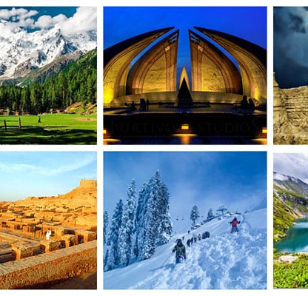
OVERVIEW
ATG is a web-based GUI application providing tailored travel support within Pakistan to end users. Usually, the tour websites do not provide a good GUI, but ATG attracts user via its front-end and provides all in one easily understandable features. It provides hassle-free and complete services in the domain of customized tours, hotels, flights, and transportation.

Slide 4
PORTALS
USER
ADMIN
TOUR GUIDE

Slide 5


ADMIN PORTAL
The ATG provides a user-friendly interface to add, delete, and update different databases (transport, flights, etc.) based on updated user’s data and overall availability of hotels and transportations.

Slide 6


USER PORTAL
The ATG provides a user-friendly interface to all users to select their preferred tours, and avail hotel and transport services from us if interested.

Slide 7


TOUR GUIDE PORTAL
The ATG will provide a User Interface to the Tour Guide accompanying the tours booked by user. The tour guide can view when he’ll be departing with whom (the user) at some specified date and period.

Slide 8
FEATURES
TOURS
FLIGHTS
TRANSPORTATION
HOTELS

Slide 9
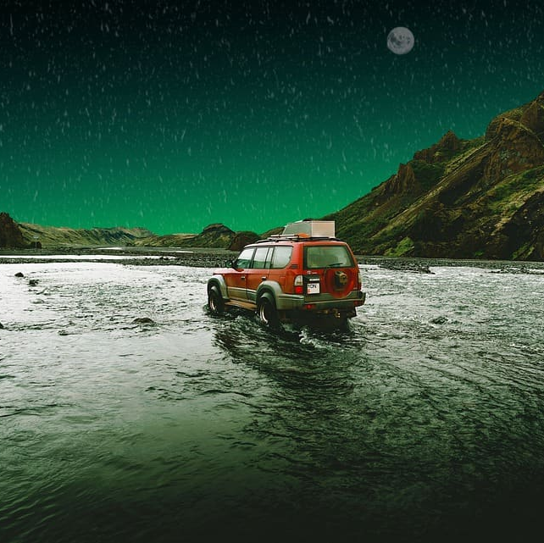
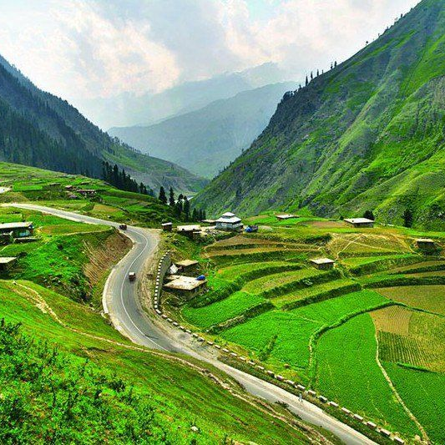
TOURS
ATG provides tour packages along with fixed rates. The complete description and pictorial transitions of each place included in the tour package are provided so that users can select the package as per their interest. Once they decide on a specific tour package, they can avail of transportation and hotel services as per their budget and feasibility. This will provide a customization facility to users regarding the mode of transportation and hotel preferences.

Slide 10


TRANSPORTATION
According to the number of travelers in your group, you can select the appropriate vehicle (Daewoo, HiAce, Cars) depending on your budget and needs (AC, Seats, etc.). All available vehicles will be stored in a database. They will be booked as per the users’ needs

Slide 11
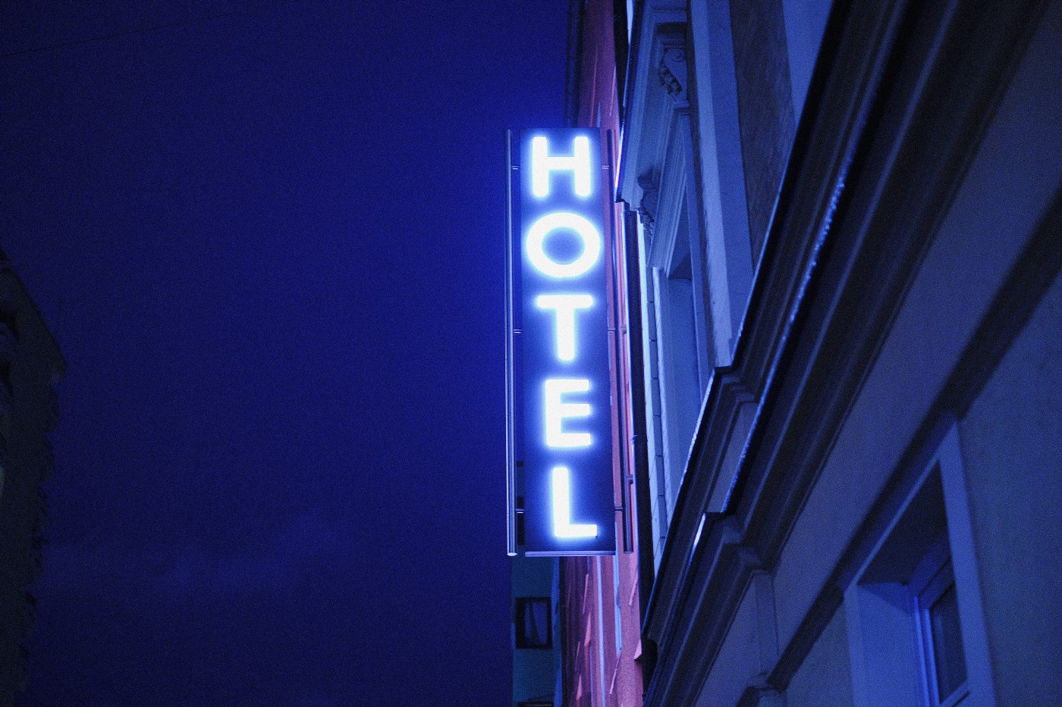

HOTELS
According to the preference of a user regarding the location of the hotel (whether safe or not), number of rooms, facilities, etc., the hotels will be booked extracted from the database.

Slide 12
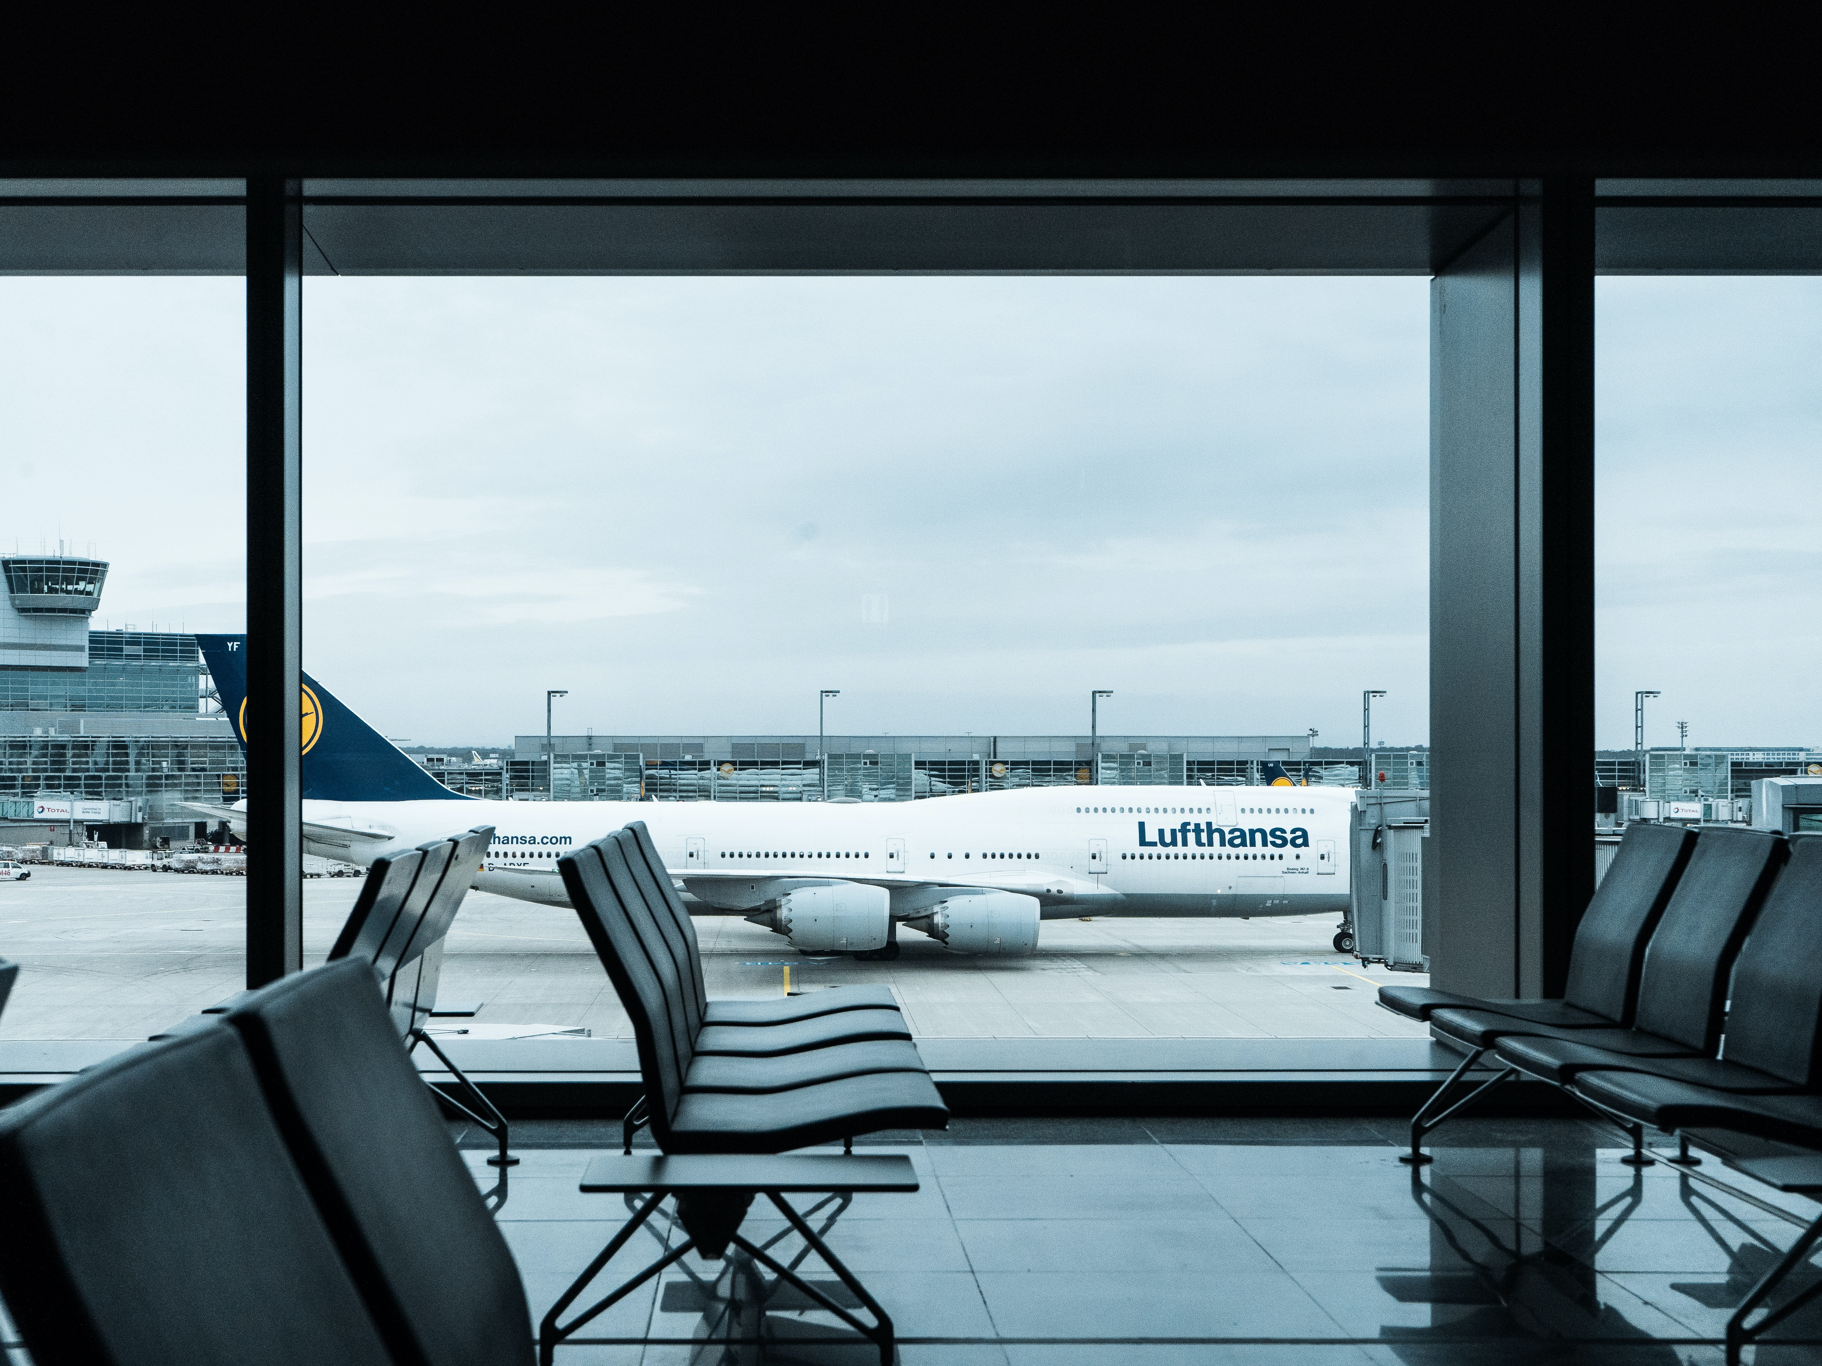
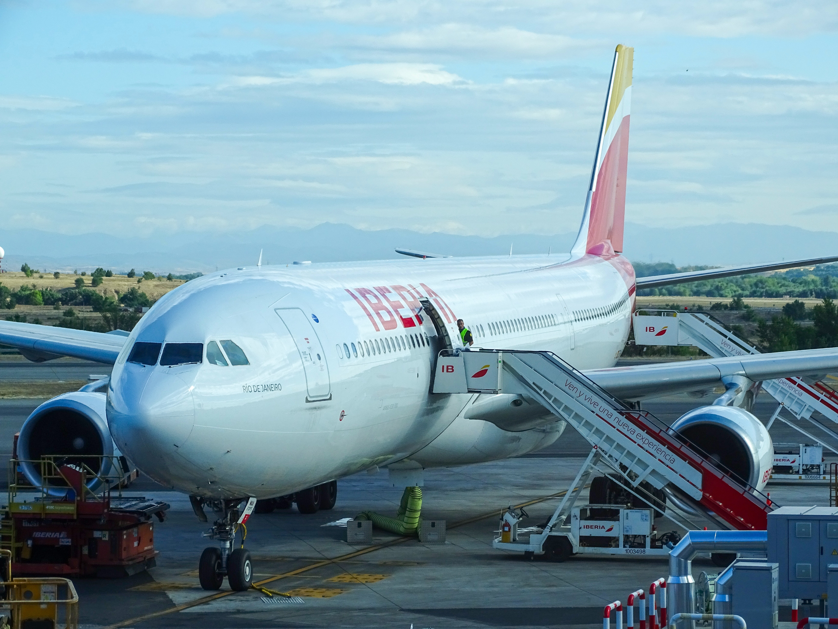
FLIGHTS
This facility can be availed by any user regardless of whether they are part of any tour package or not. In any case, it provides all-time low-cost fares, ranging in age, offerings like never before. All available flights will be stored in a database. They will be displayed as per the users’ needs.

Slide 13
SOFTWARE DEVELOPMENT DIAGRAMS
DOMAIN MODEL
CLASS DIAGRAM
USE CASE DIAGRAM
COMPONENT DIAGRAM
ACTIVITY DIAGRAM
SEQUENCE DIAGRAM
COMMUNICATION DIAGRAM
STATE CHART DIAGRAM
DEPLOYEMENT DIAGRAM

Slide 14
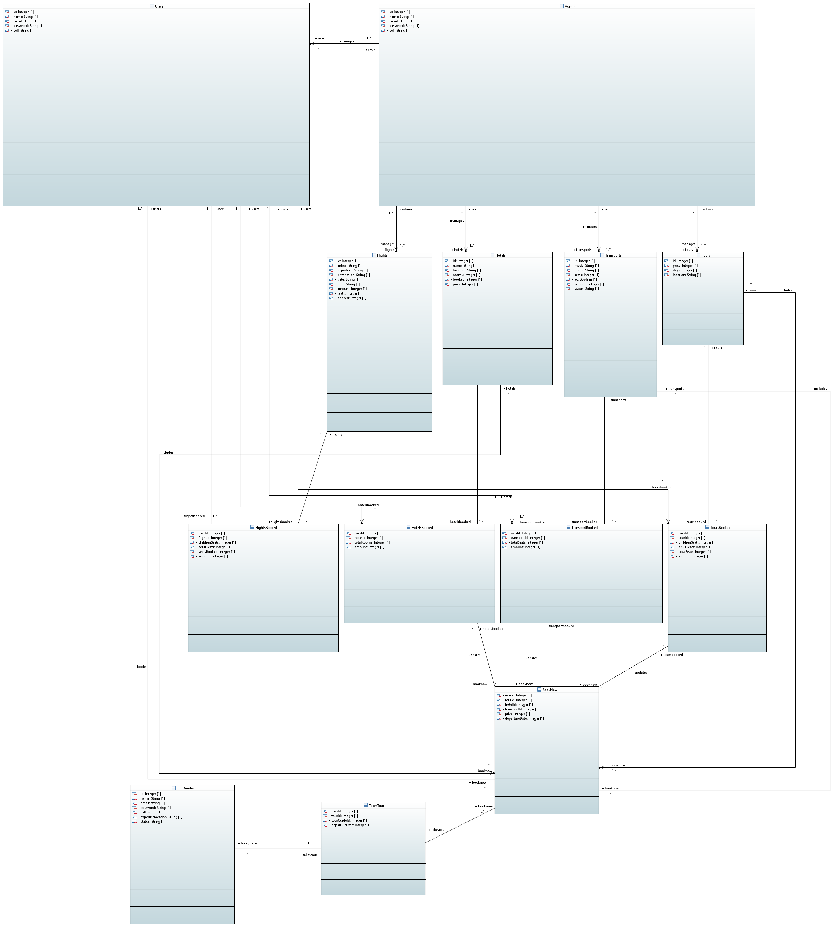
DOMAIN MODEL

Slide 15
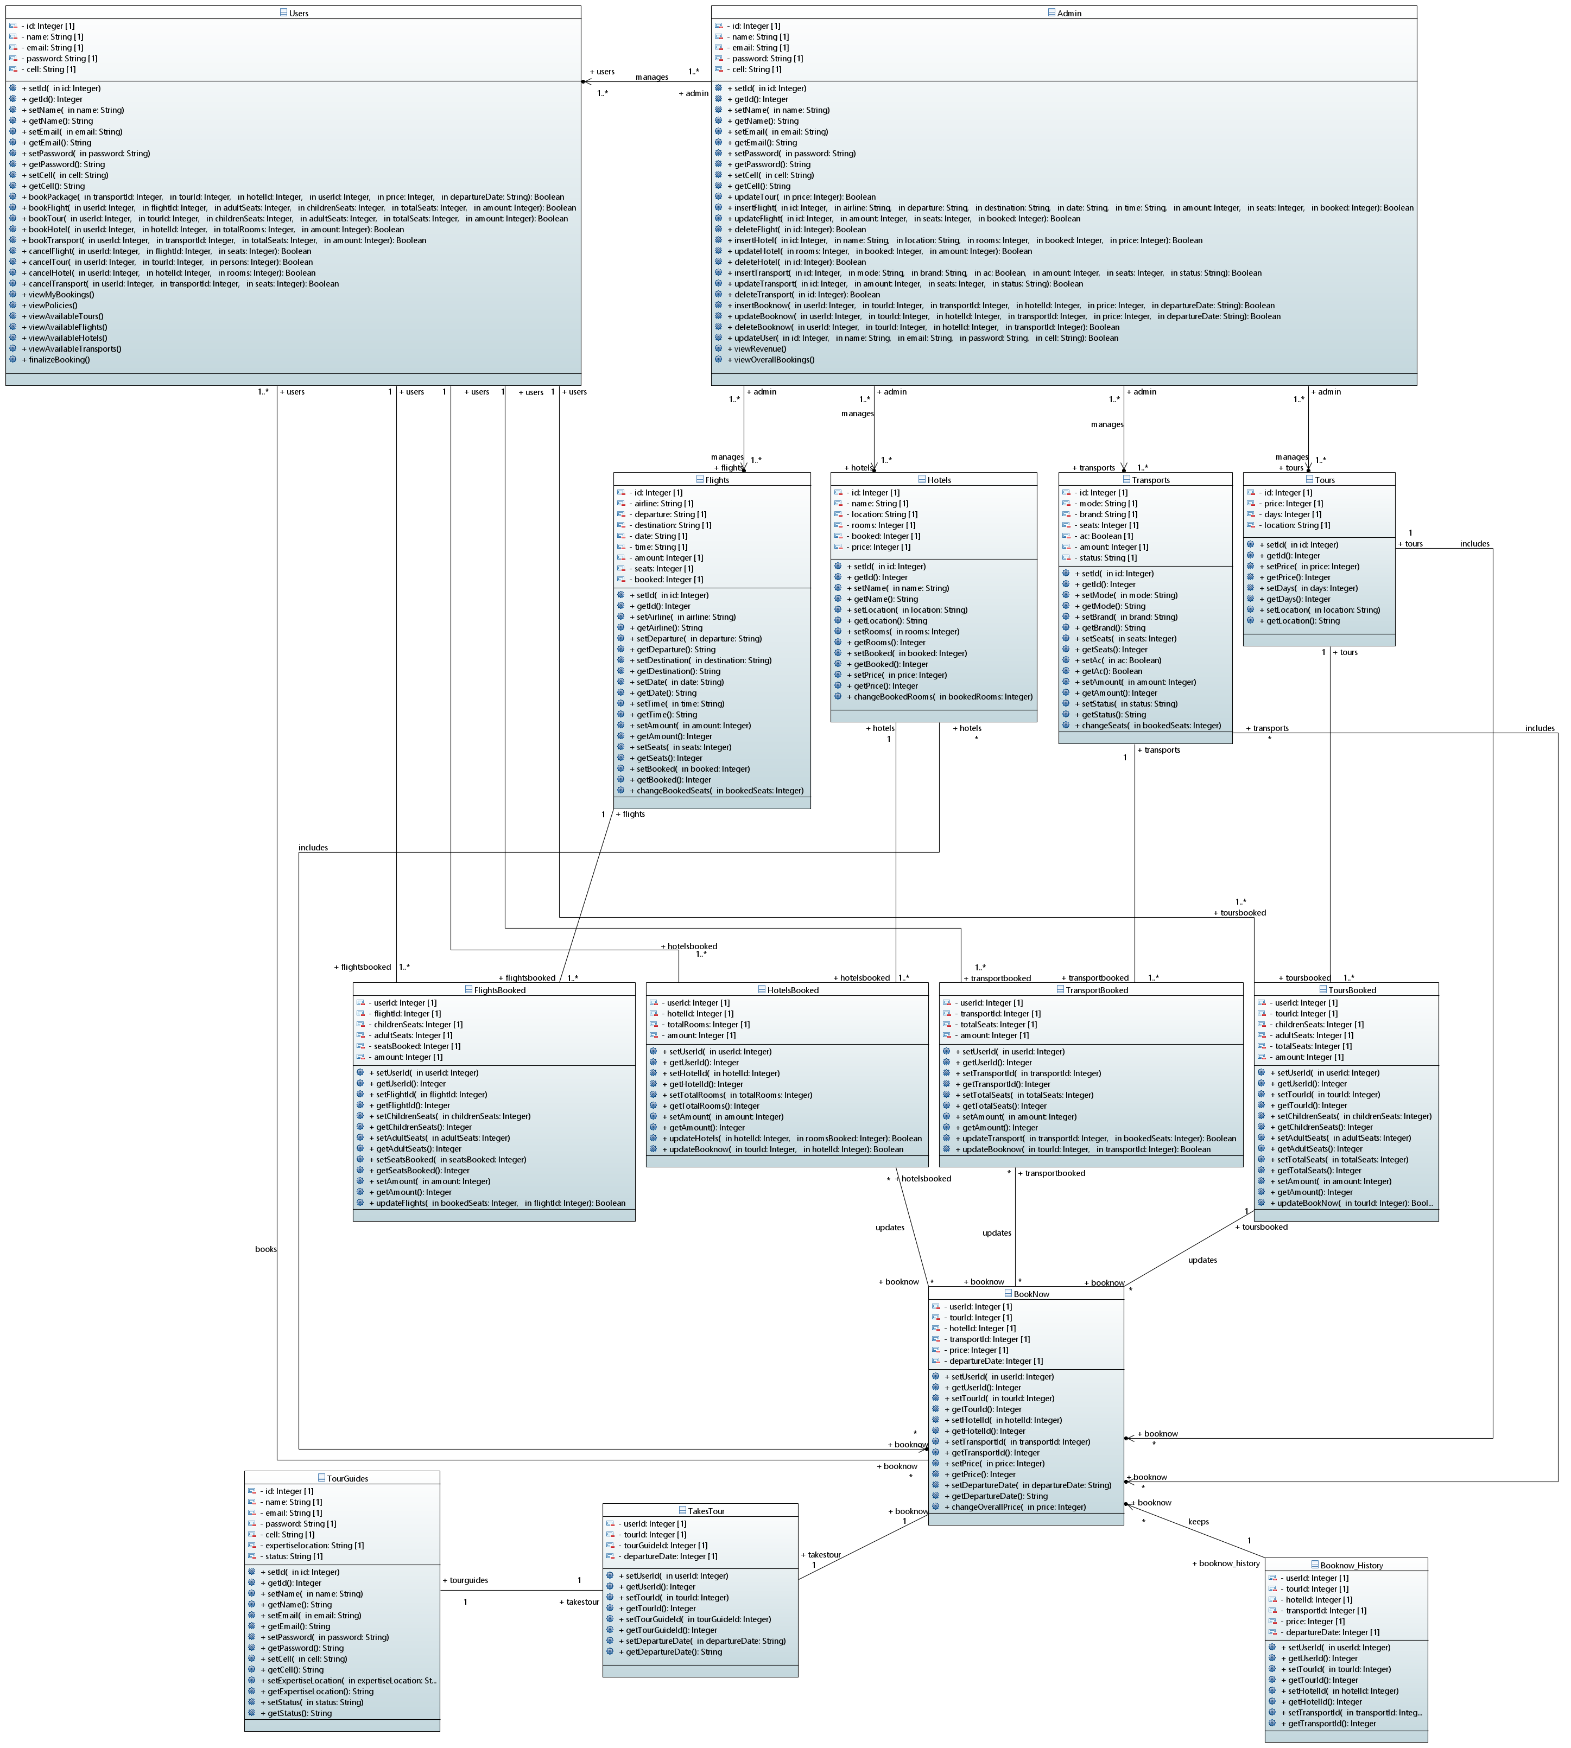
CLASS DIAGRAM

Slide 16
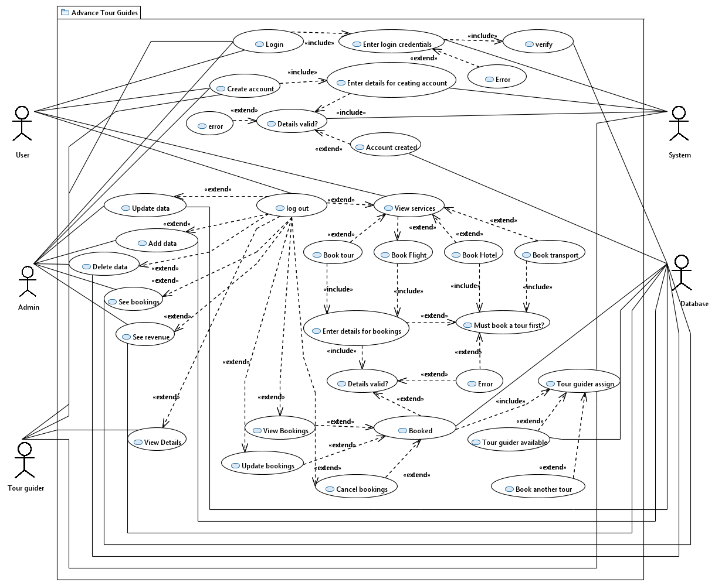
USE CASE DIAGRAM

Slide 17
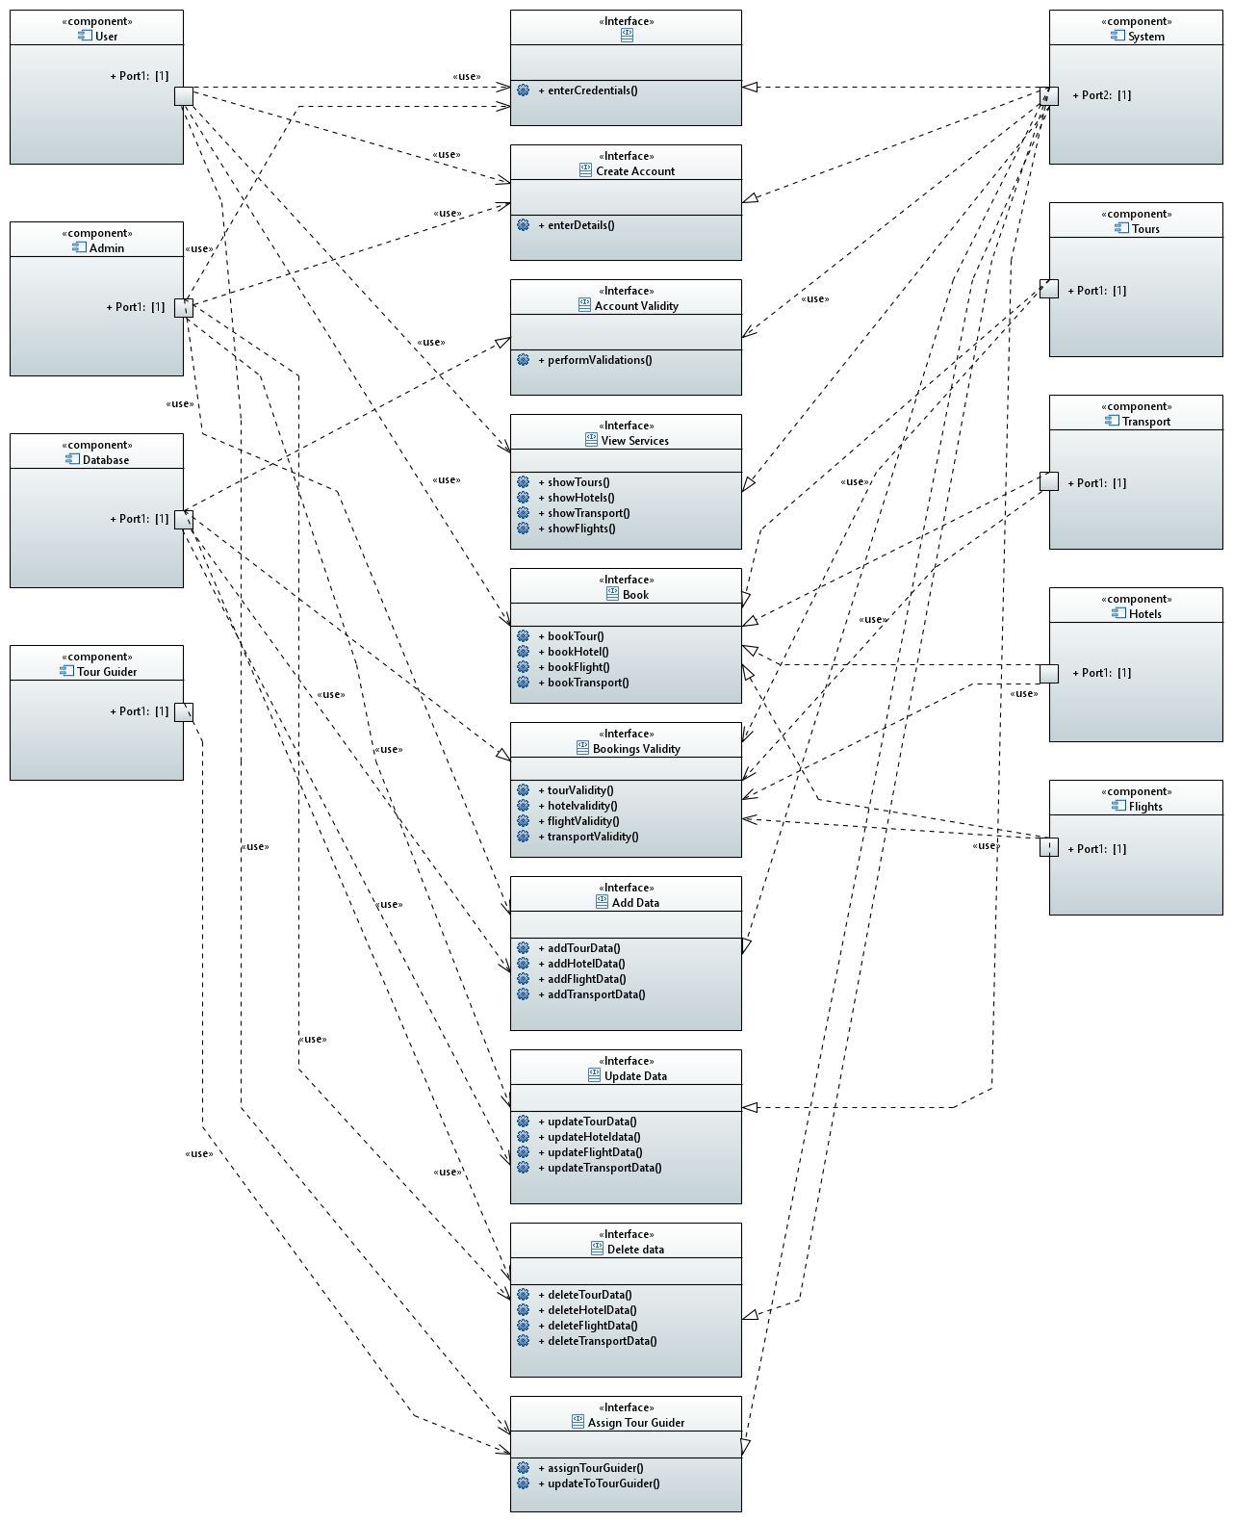
COMPONENT DIAGRAM

Slide 18
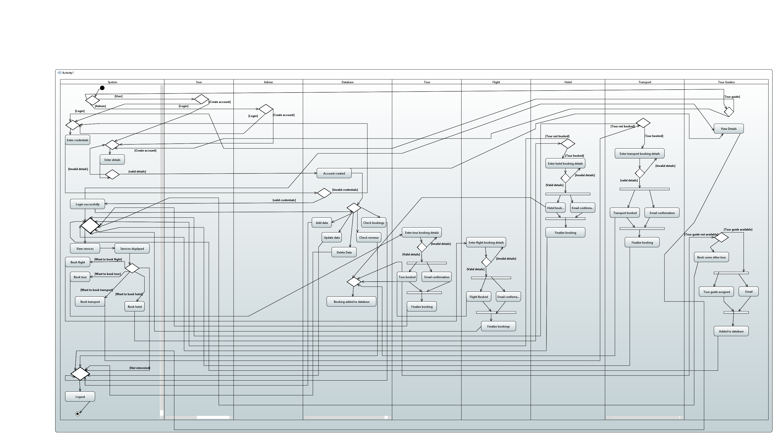
ACTIVITY DIAGRAM

Slide 19
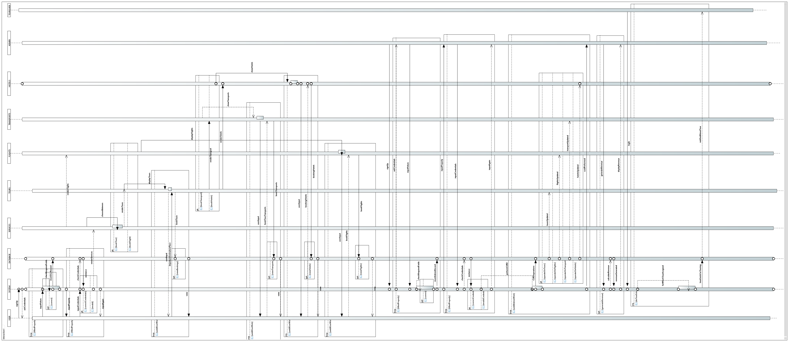
SEQUENCE DIAGRAM

Slide 20
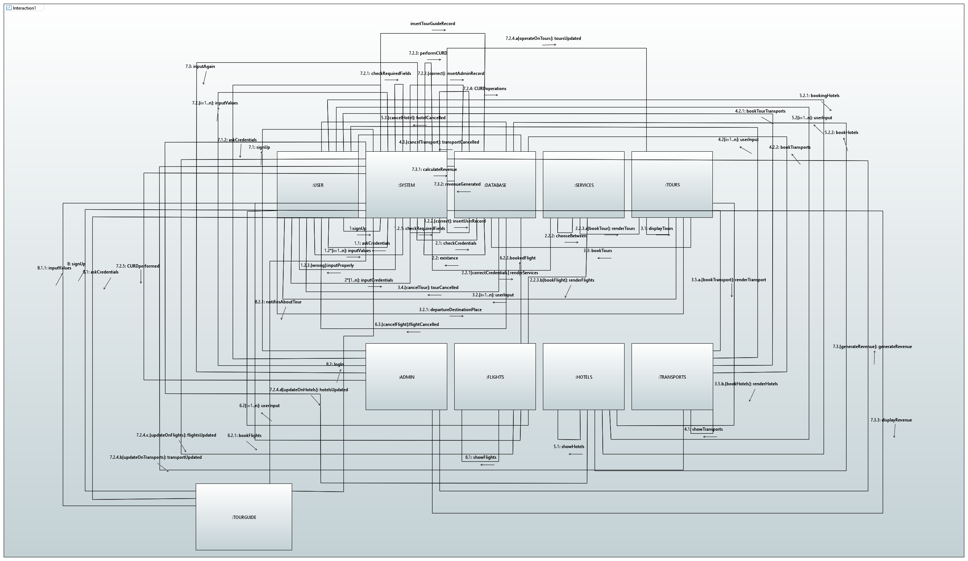
COMMUNICATION DIAGRAM

Slide 21
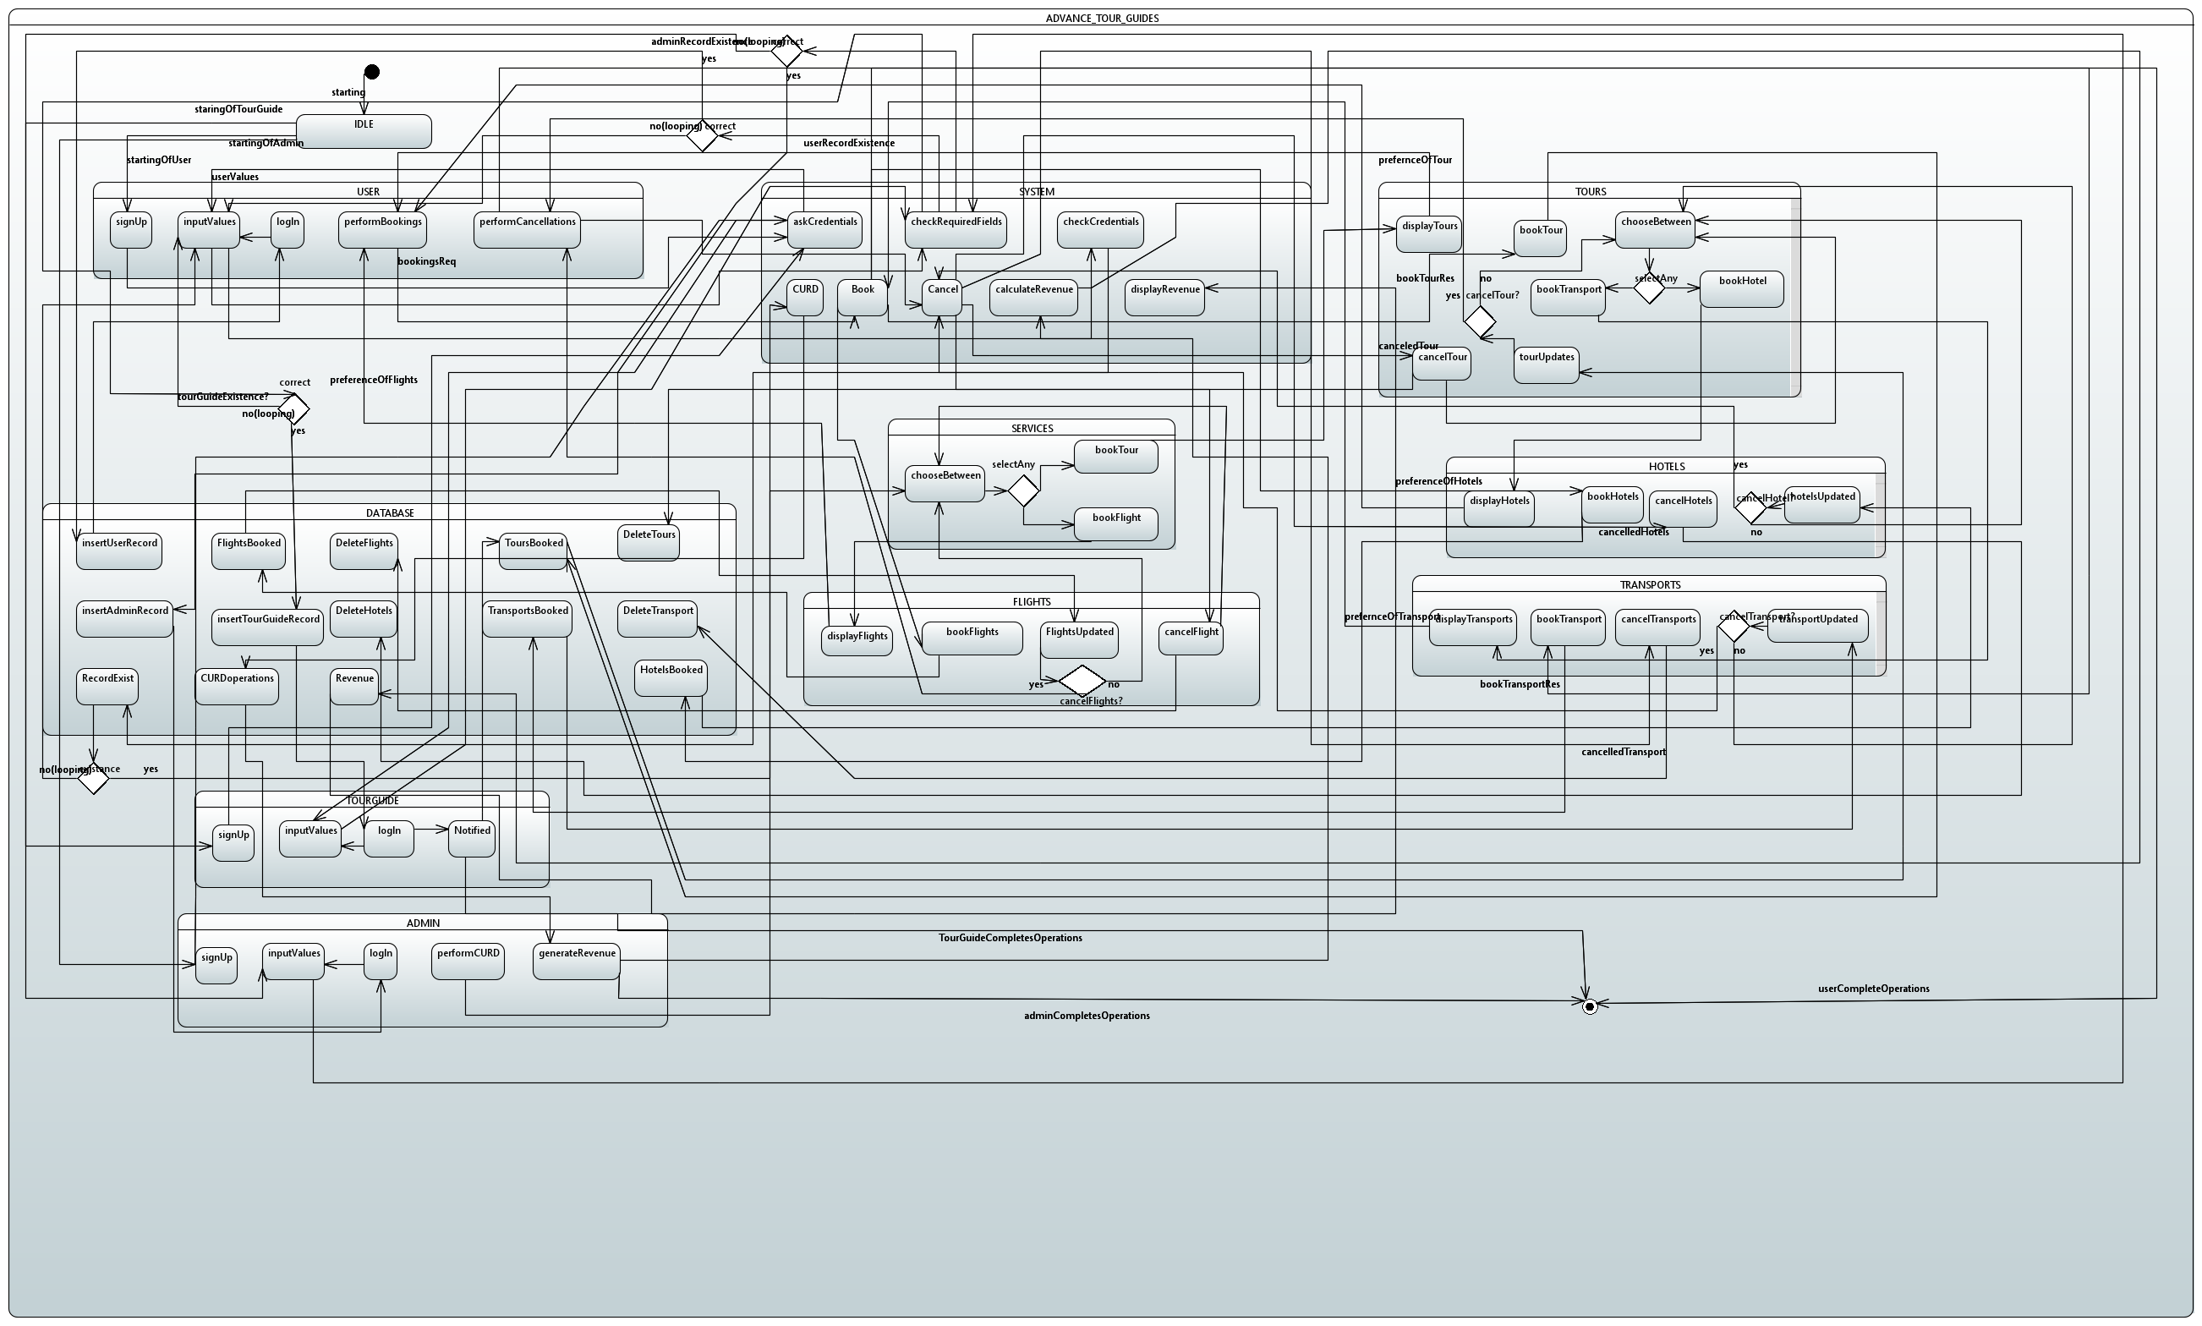
STATE CHART DIAGRAM

Slide 22
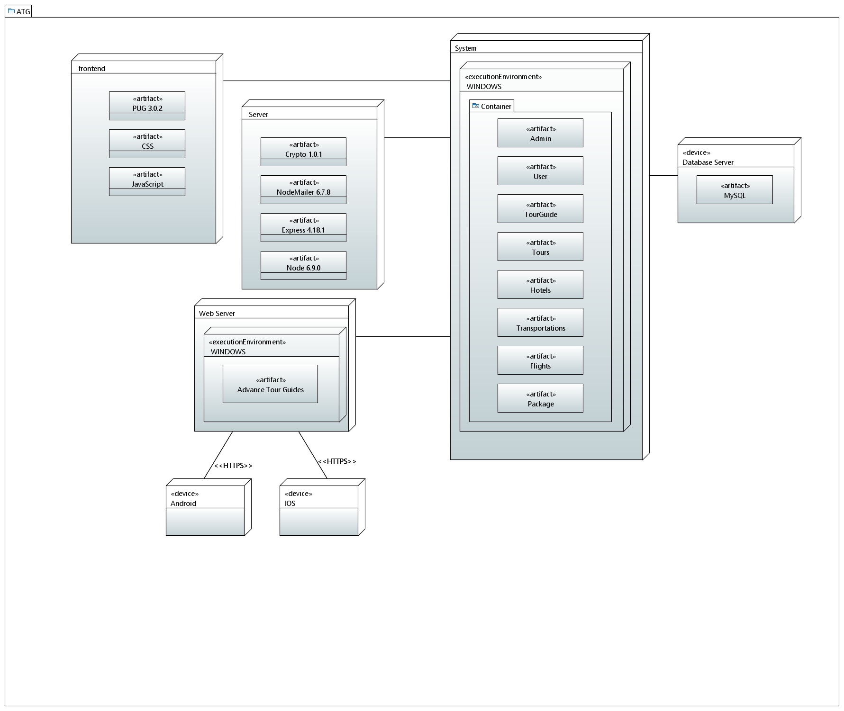
DEPLOYEMENT DIAGRAM

Slide 23
TOOLS & TECHNOLOGIES

Slide 24


TOOLS
FRONT-END: Pug, CSS.
BACK-END: JavaScript, Nodejs, Expressjs.
DATABASE: MySQL (stored and accessed from PHP MY ADMIN), and Apache.

Slide 25
THE TEAM

Slide 26


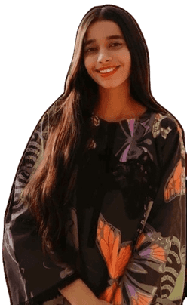
TEAM
YUSRA ADAM
K200207
Name Title
INSHA SAMNANI
K200247
ISMAIL ANSARI
K200228

Slide 27
THANK YOU
FOR ANY QUERIES:
advancetourguide@gmail.com
SUBMITTED TO:
DR.MOAZZAM HAIDER

